Slide 1
Sandhiya N
Final Project
3/21/2024 Annual Review

Slide 2
SENTIMENT ANALYSIS FOR AIRLINE REVIEWS
3/21/2024 Annual Review

Slide 3


AGENDA
Introduction
Overview of sentiment analysis purpose for airlines.
Importance of understanding customer sentiment.
2. Data Collection
Methods for gathering customer feedback data.
Consideration of data sources like social media, surveys, etc.
3. Sentiment Analysis Techniques
Explanation of sentiment analysis methods.
Comparison of rule-based, machine learning, and deep learning approaches.
4. Analysis and Visualization
Conduct sentiment analysis on collected data.
Visualization of sentiment trends and insights.
5. Insights and Action Plan
Derive actionable insights from analysis.
Develop a plan for addressing findings to improve customer satisfaction and brand reputation.
3/21/2024 Annual Review

Slide 4

PROBLEM STATEMENT "In the airline industry, understanding and managing customer sentiment is crucial for maintaining customer satisfaction, loyalty, and brand reputation. However, with the vast amount of unstructured data generated from various sources such as social media, customer reviews, and surveys, extracting meaningful insights becomes challenging. Therefore, the problem statement for sentiment analysis for airlines revolves around developing a robust methodology to accurately analyze and interpret customer sentiment from diverse data sources. This includes addressing challenges such as noisy data, sentiment ambiguity, and the need for real-time analysis. The goal is to derive actionable insights that enable airlines to proactively address issues, enhance the customer experience, and strengthen their competitive position in the market."
3/21/2024 Annual Review

Slide 5

PROJECT OVERVIEW 1. Objective: - Conduct sentiment analysis on airline customer feedback data to understand customer perceptions and emotions towards the airline's services, brand, and overall experience. 2. Methodology: - Gather customer feedback data from multiple sources such as social media, surveys, and review platforms. - Preprocess the data to remove noise and standardize text format. 3. Analysis and Insights: - Analyze sentiment polarity and trends to identify areas of strength and improvement. - Extract actionable insights from sentiment analysis results to enhance the customer experience and brand reputation. 4. **Visualization**: - Visualize sentiment analysis results through charts, graphs, and dashboards to facilitate easy interpretation and decision-making. 5. **Recommendations and Implementation**: - Develop recommendations based on insights derived from sentiment analysis. - Create an implementation plan outlining steps for addressing identified issues and improving customer satisfaction.
3/21/2024 Annual Review

Slide 6

WHO ARE THE END USERS? 1. Customer Experience Teams: - Customer experience teams within the airline are primary end users. They utilize sentiment analysis insights to understand customer satisfaction levels, identify pain points in the customer journey, and prioritize improvements to enhance overall customer experience. 2. Marketing Departments: - Marketing departments utilize sentiment analysis to gauge public perception of the airline's brand, advertising campaigns, and promotional efforts. Insights from sentiment analysis help in crafting targeted marketing strategies and messaging. 3. Operations and Service Teams: - Operations and service teams rely on sentiment analysis to identify operational inefficiencies and service gaps. They use sentiment analysis insights to optimize processes, improve service quality, and address customer complaints in real-time. 4. Product Development Teams: - Product development teams leverage sentiment analysis to gather feedback on existing services and products. Insights derived from sentiment analysis aid in the development of new offerings and enhancements to meet customer needs and preferences.
3/21/2024 Annual Review

Slide 7

YOUR SOLUTION AND ITS VALUE PROPOSITION
1.Comprehensive Sentiment Analysis:
- Our solution offers a comprehensive sentiment analysis framework tailored specifically for the airline industry. By analyzing customer feedback from diverse sources such as social media, surveys, and review platforms, we provide a holistic view of customer sentiment towards the airline.
2. Actionable Insights:
- We deliver actionable insights derived from sentiment analysis results, enabling airlines to identify key areas of improvement and prioritize efforts to enhance the customer experience. Our solution helps in pinpointing specific pain points, addressing customer complaints, and optimizing service delivery.
3. Real-time Monitoring:
- Our solution enables real-time monitoring of customer sentiment, allowing airlines to promptly respond to emerging issues and trends. By continuously analyzing feedback data, airlines can stay agile and proactive in addressing customer concerns, thereby fostering greater customer satisfaction and loyalty.
3/21/2024 Annual Review

Slide 8

THE WOW IN YOUR SOLUTION
Tailored Insights:
Our solution delivers tailored insights by understanding the unique nuances of the airline industry. We go beyond generic sentiment analysis to provide specific insights relevant to airline operations, such as flight experiences, booking processes, and onboard services, ensuring that airlines receive actionable recommendations that directly impact customer satisfaction.
Predictive Analytics:
We utilize advanced predictive analytics techniques to forecast future sentiment trends based on historical data and external factors such as seasonality, events, and market trends. By anticipating shifts in customer sentiment, airlines can proactively implement strategies to mitigate negative sentiment and capitalize on positive sentiment, staying ahead of the competition.
360-Degree Sentiment Monitoring:
Our solution offers a 360-degree approach to sentiment monitoring, capturing feedback from all touchpoints along the customer journey, including pre-flight, in-flight, and post-flight experiences. This comprehensive coverage allows airlines to gain a holistic understanding of customer sentiment and make informed decisions to improve overall customer satisfaction.
3/21/2024 Annual Review
8

Slide 9
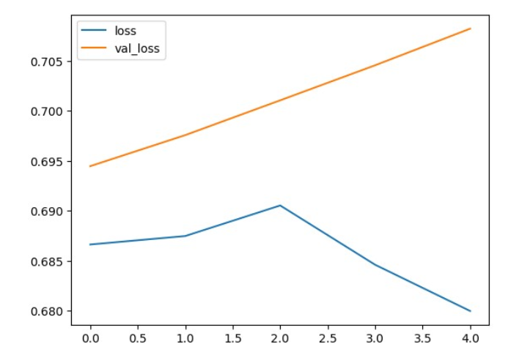
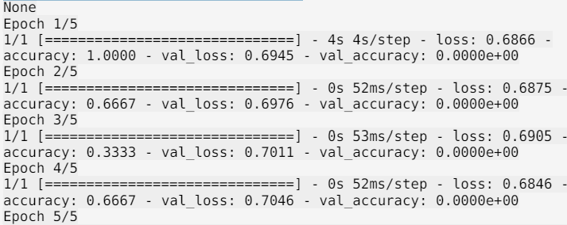
MODELLING
3/21/2024 Annual Review
9

Slide 10
RESULTS
1. Key Insights and Trends:
- Our sentiment analysis uncovers key insights and trends regarding customer sentiment towards the airline. By analyzing vast amounts of feedback data from various sources, we identify prevalent themes, sentiment patterns, and emerging issues that impact the overall customer experience.
2. Actionable Recommendations:
- Based on the sentiment analysis results, we provide actionable recommendations to address identified pain points and enhance customer satisfaction. These recommendations are tailored to the specific needs and challenges of the airline, enabling proactive measures to improve service quality and mitigate negative sentiment.
3. Measurable Impact:
- Through the implementation of recommended strategies and initiatives, our sentiment analysis results in a measurable impact on customer sentiment metrics. Whether it's an increase in positive sentiment scores, a reduction in negative feedback, or improvements in overall customer satisfaction ratings, our analysis demonstrates tangible outcomes that contribute to the airline's success.
Demo Link
3/21/2024 Annual Review
10

